Slide 1

Sales analysis
by Sameera banu m

Slide 2
Online retail dataset

Slide 3
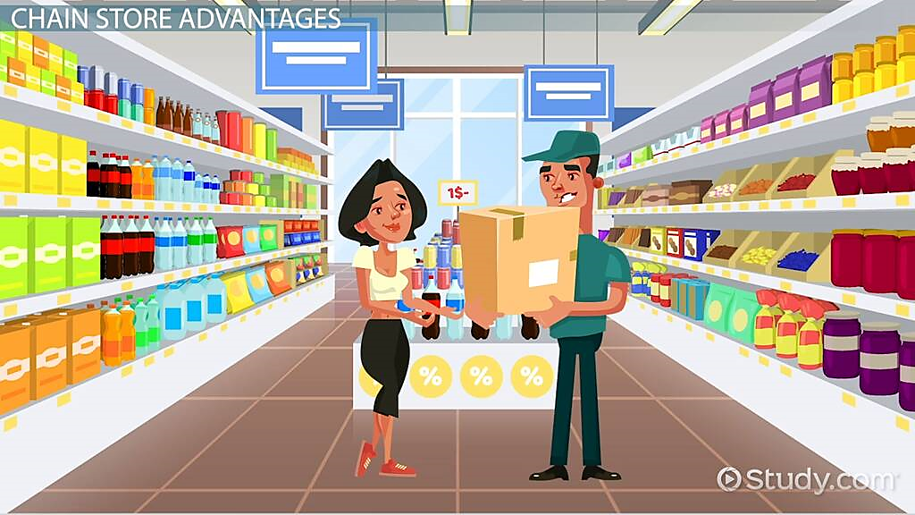
About
Our Retail stores display and sell products to customers, either in brick-and-mortar locations or online. We also provide door-delivery options to improve our sales.
The data that we collected across the different countries about sales to improve our insights towards the marketing as well as the advertising.
Here,I have collected a dataset and done some of the techniques to provide visualization.

Slide 4





DATA CLEANING
To improve
collection
cleaning
Visualisation
Margins

Slide 5
Analysis Process 1
The CEO of the retail store is interested to view the time series of the revenue data for the year 2011 only. He would like to view granular data by looking into revenue for each month. The CEO is interested in viewing the seasonal trends and wants to dig deeper into why these trends occur. This analysis will be helpful for the CEO to forecast for the next year.
.

Slide 6
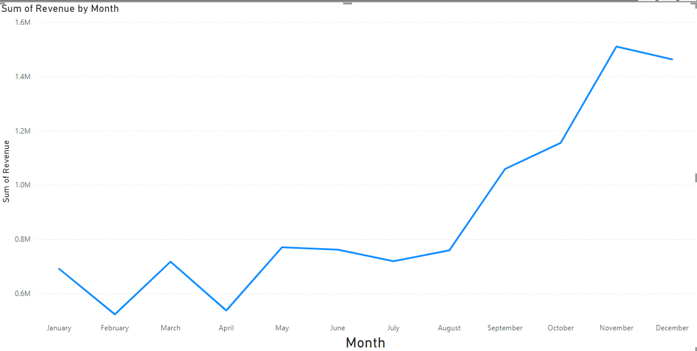
How will the sales in 2011
Phase 2
Phase 3

Slide 7
Analysis Process 2
The CMO is interested in viewing the top 10 countries which are generating the highest revenue. Additionally, the CMO is also interested in viewing the quantity sold along with the revenue generated. The CMO does not want to have the United Kingdom in this visual.
.

Slide 8
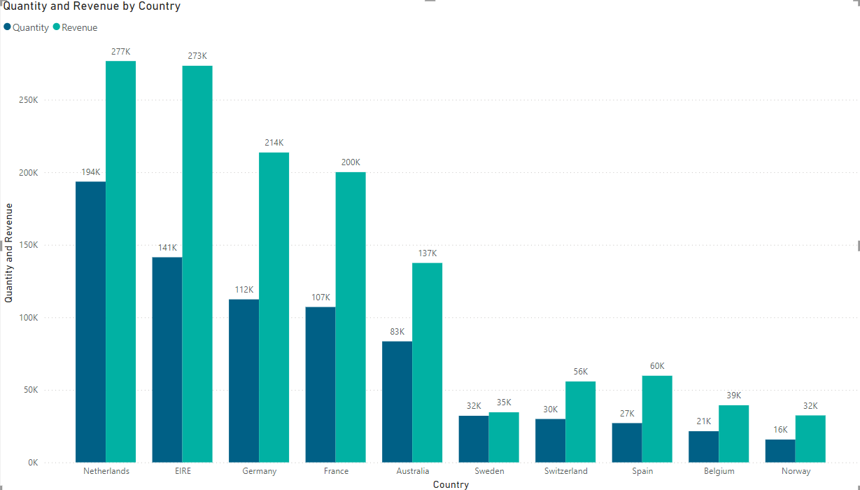
Revenue based on the Country
Phase 2
Phase 3

Slide 9
Analysis Process 3
The CMO of the online retail store wants to view the information on the top 10 customers by revenue. He is interested in a visual that shows the greatest revenue generating customer at the start and gradually declines to the lower revenue generating customers. The CMO wants to target the higher revenue generating customers and ensure that they remain satisfied with their products.
.

Slide 10
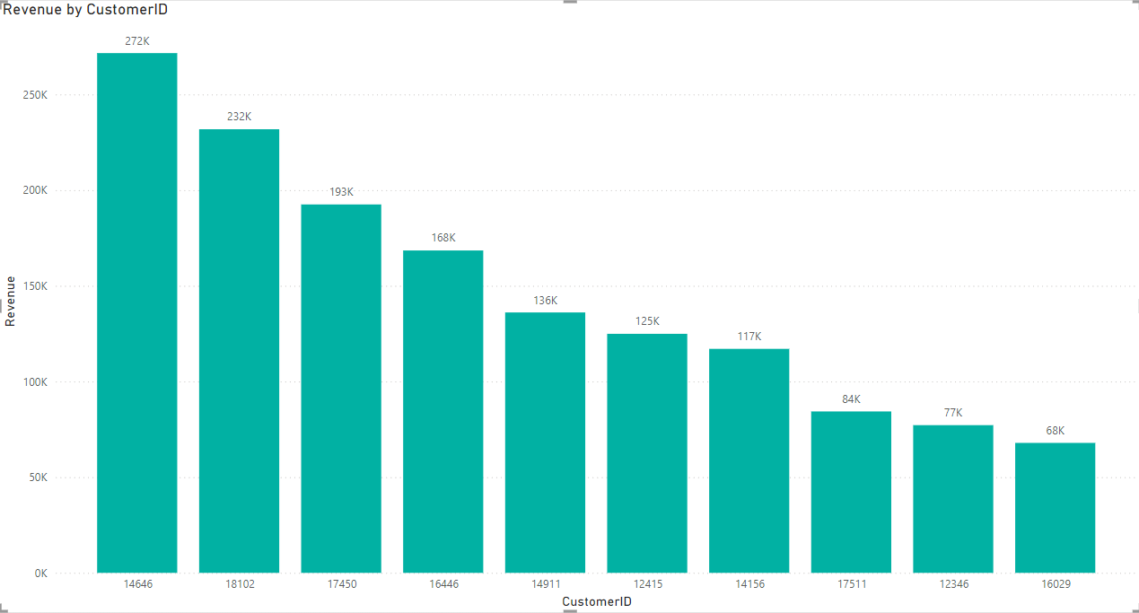
Top 10 Customers
Phase 2
Phase 3

Slide 11
Analysis Process 4
The CEO is looking to gain insights on the demand for their products. He wants to look at all countries and see which regions have the greatest demand for their products. Once the CEO gets an idea of the regions that have high demand, he will initiate an expansion strategy which will allow the company to target these areas and generate more business from these regions. He wants to view the entire data on a single view without the need to scroll or hover over the data points to identify the demand. There is no need to show data for the United Kingdom as the CEO is more interested in viewing the countries that have expansion opportunities.
.

Slide 12
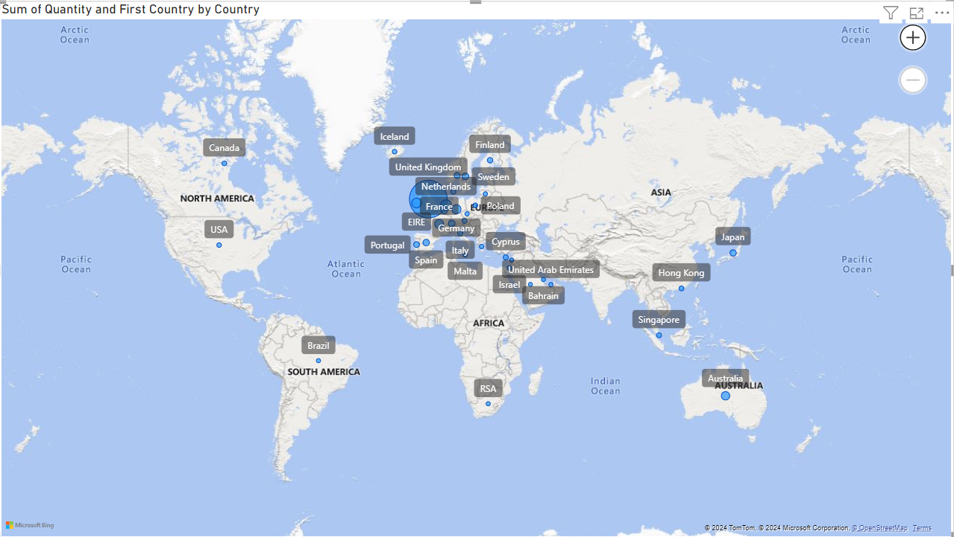
Demand of the Product based on Country
Phase 2
Phase 3

Slide 13

Summary
The Sales was high in Winter season,so if we start manufacturing additional products on Jan,it will be useful to gain profits.
By Selecting Top 10 customer we can provide selective Offers to them and to retain them.
By finding which region have the highest will merely support us in the Manufacturing and Production process.
Sales Report

Slide 14


Thank You
Sameera Banu M
sameeramansoor03@gmail.com

